Slide 1
2025 Formula 1 Season
Emma Kovács

Slide 2
Questions
How do different engine providers impact lap times?
What is the most common team to get in the top 3?
Does the winner have the best car overall?
What is the average lap time of the top 3 finishers over all the races?

Slide 3
Audience + Goal
The target audience for this data project are Formula 1 fans or anyone curious to know more about Formula 1 in general.
The goal of this data story is to improve understanding of how the sport works, and to maybe change the perspective of how we view teams and how they performed during the 2025 season.

Slide 4
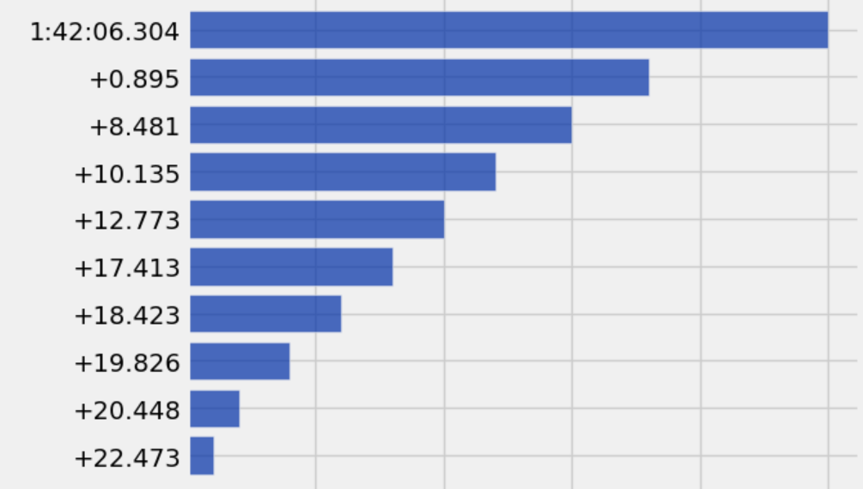
Analysis
This bar chart shows the lap time of the winner for the first Grand Prix of the year, with the average time others were behind the winning lap time.
This bar chart also shows the average amount of points each lap time earns by the length of the bars. It can be seen that the faster the lap time is the more points are awarded.

Slide 5
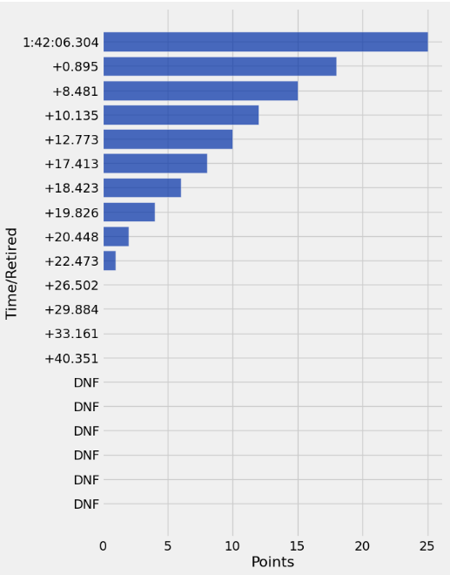
Analysis
On this bar chart we can see that not everyone gets points even if they finished the race. Only the top ten receive points, and the points get lower, the farther away the lap times get from the winning time.

Slide 6
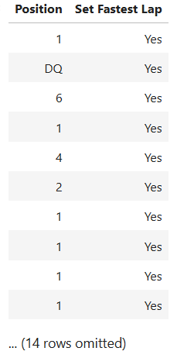
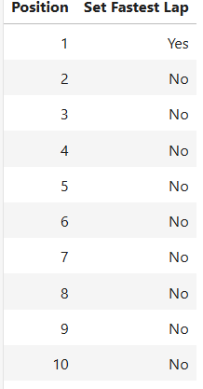
Analysis
The table shows whether or not a driver got the fastest lap or not. It is more common for a driver that wins or finishes in a higher position to get the fastest lap as well. There are some outliers however, such as the DQ driver, which stands for disqualified, and the driver that got fastest but finished in 6th.

Slide 7
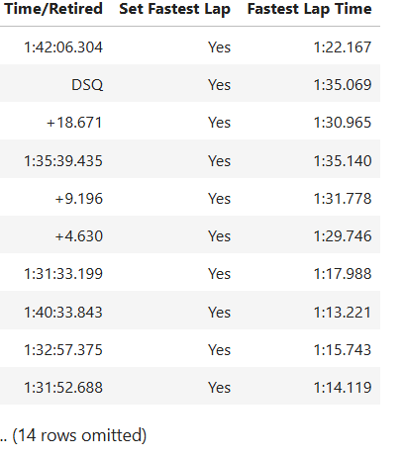
Analysis
This table shows the lap time of all the drivers that got the fastest lap of the race for every race of the season. The ‘Time/Retired’ column shows the amount of time it took each driver to finish the race. If the number has a + in front of it, then it is the amount of time they finished behind 1st place, since they finished lower than 1st. The ‘Fastest Lap Time’ column shows the actual time of the fastest lap set in the race.

Slide 8
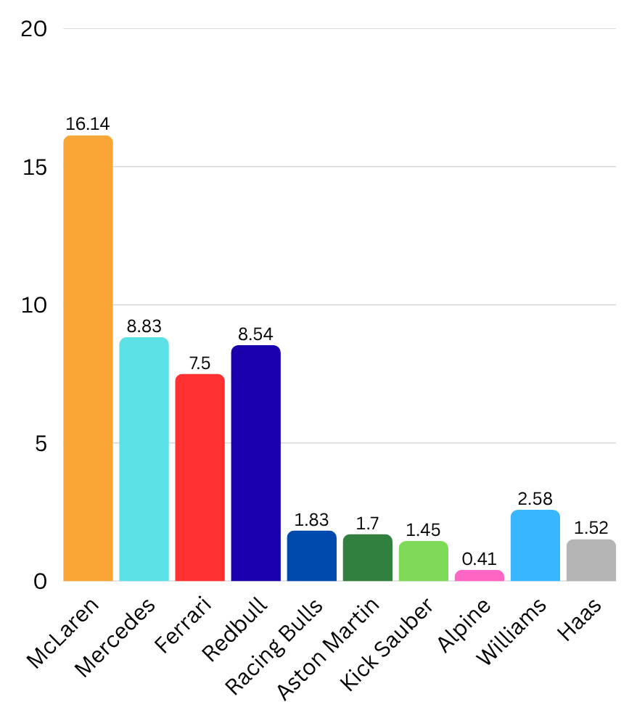
Analysis
This chart shows the overall average of points each team scored over the entire 2025 season. We can see that based on points, McLaren won the Constructors Championship, and from the other’s points we can figure out the standing order of each team by the end of the season.

Slide 9
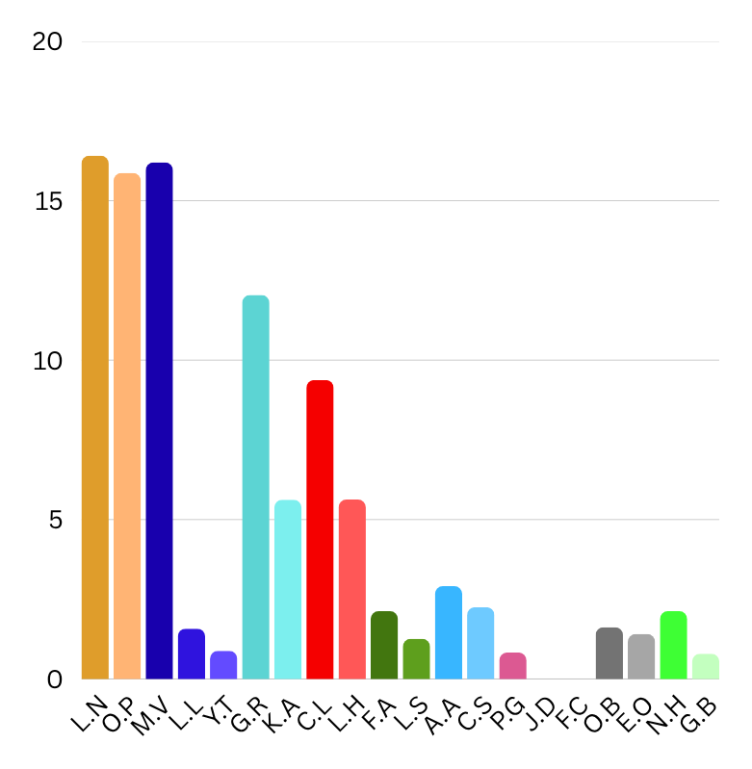
Analysis
This chart shows the overall average of points each driver scored over the entire 2025 season. We can see that based on points, Lando Norris won the Drivers Championship, and from the other’s points we can figure out the standing order of the drivers by the end of the season.
Comparing this with the overall team average points shows how many points each driver contributed to the team as well.

Slide 10
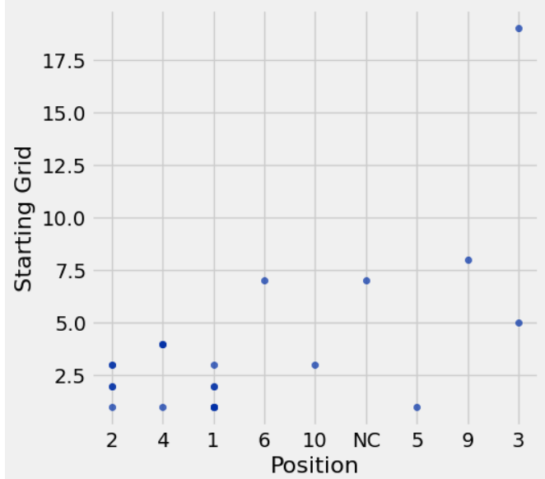
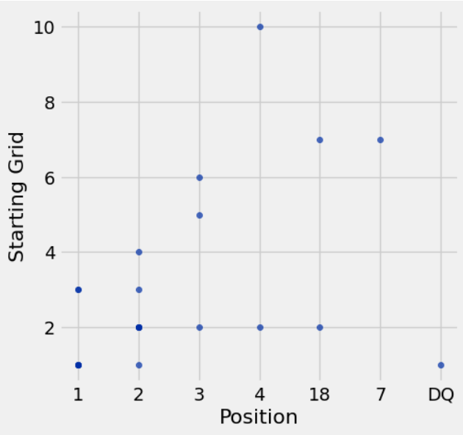
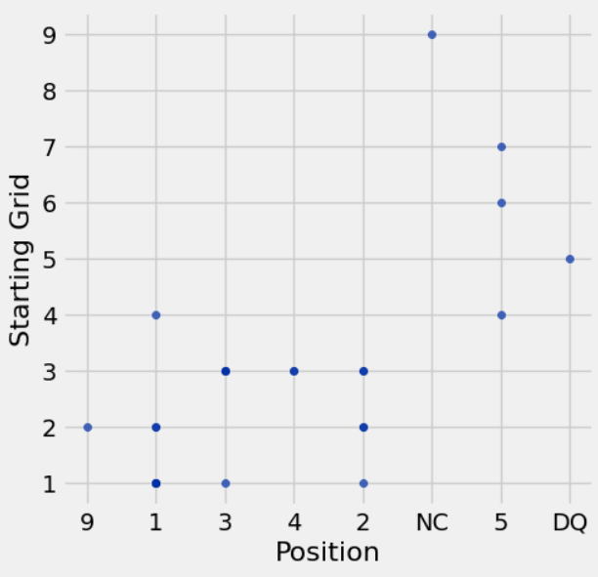
Top 3 Championship Driver’s Starting vs. Finishing Positions
Lando Norris - 1st
Oscar Piastri - 3rd
Max Verstappen - 2nd
(analysis on next slide)

Slide 11
Analysis
The scatter plots above show each of the top 3 drivers starting position compared to there finishing position for each race of the season.
For Lando, we can see that, besides the disqualification at the end, he generally always started and finished within the top 10.
For Max, we see that he started many races further back, but still ended up finishing further up within the points.
For Oscar, we see more diversity in starting vs. finishing positions. However, he is mostly always seen finishing in the top 10 as well.

Slide 12
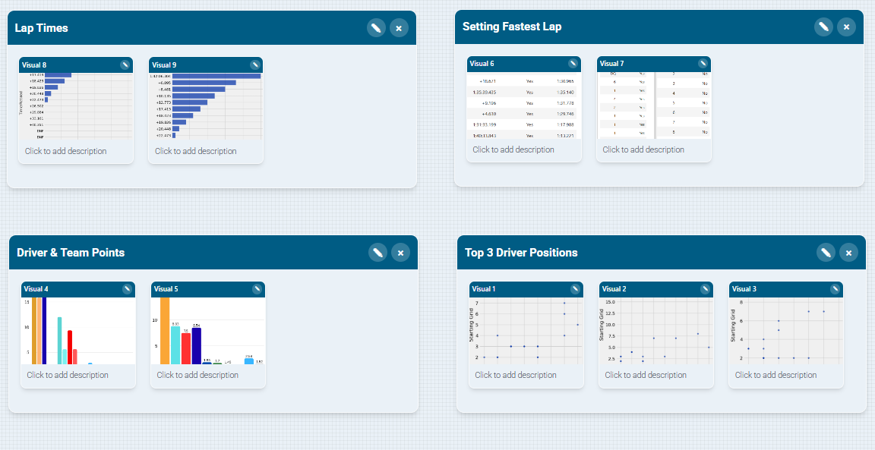
Storyboard

